Slide 1


A conversation on reproducibility and interactive notebooks with RMarkdown
Dana Miller
BEARS
January 3, 2019

Slide 2
Learning objectives
What about “reproducibility”?
What is Markdown?
Hands on:
Create an Rmarkdown document and “knit” it
Working with Rmarkdown files and git + GitHub
(As time allows) examples of other document types
Journal article templates (eg with “rticles” package)
Bookdown
Blogdown

Slide 3
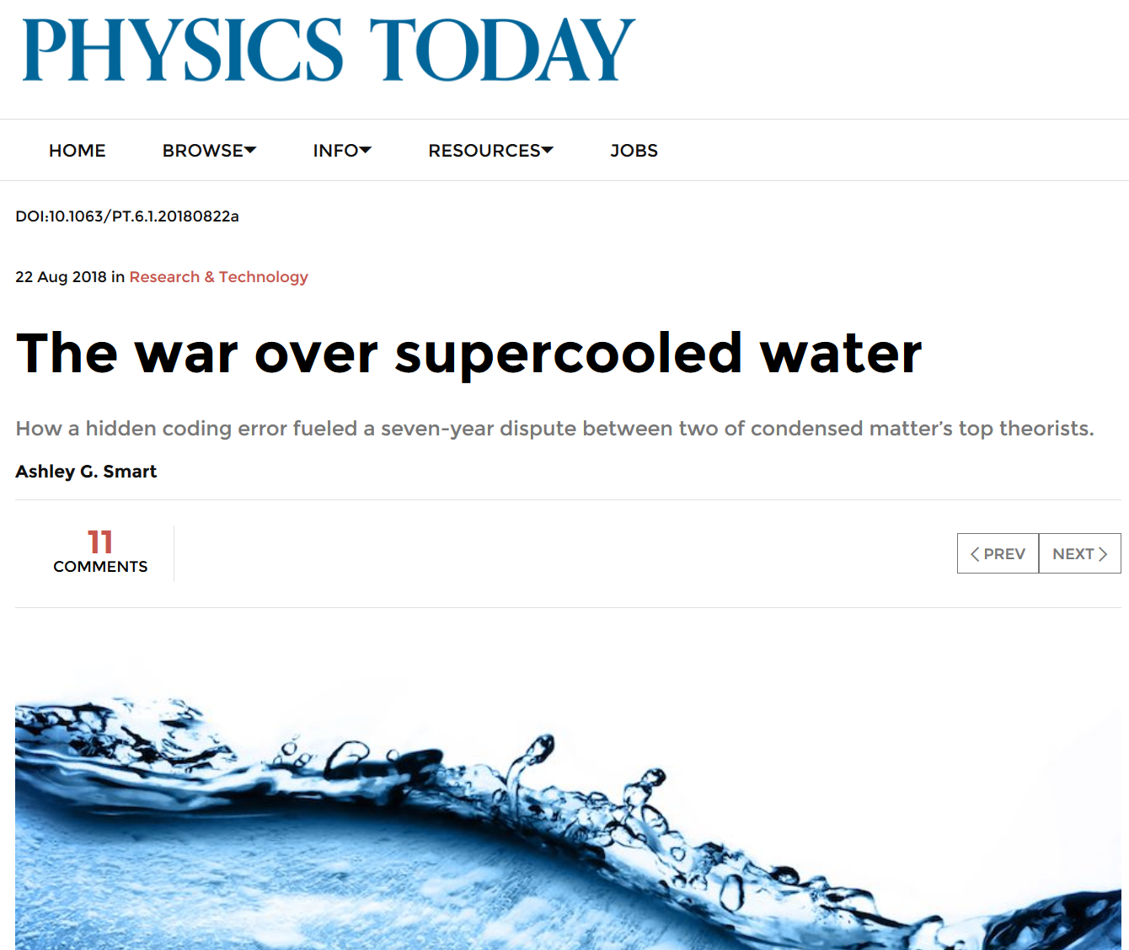
Why reproducible research? Robustness
“Limmer maintains that he and his mentor weren’t trying to hide anything. “I had and was very willing to share the code,” he says. What he didn’t have, he says, was the time or personnel to prepare the code in a form that could be useful to an outsider”
“Suddenly it made sense that the Berkeley researchers hadn’t seen a second liquid phase; they were effectively running their simulations at temperatures well above the critical point.”
https://physicstoday.scitation.org/do/10.1063/PT.6.1.20180822a/full/

Slide 4
Why reproducible research? Records
Email from grad student to Berkeley professor in 2017:
“…The citation on the slide is [your report on a state government website].
I downloaded that PDF and do not see [important statistic] anywhere in it.
Table 3 seems to have [different value] , Table 15 has [related value] in California…
…The closest match that I've found is [other statistic] from Table 15...
Is it possible there was an error in transcription? If not, can you help me figure out what's going on here? What does [important statistic] on [slide] represent?”
Response from Berkeley professor:
“I don't remember the details. [Former student], do you? Thanks in advance.”
[Former student] never responded

Slide 5
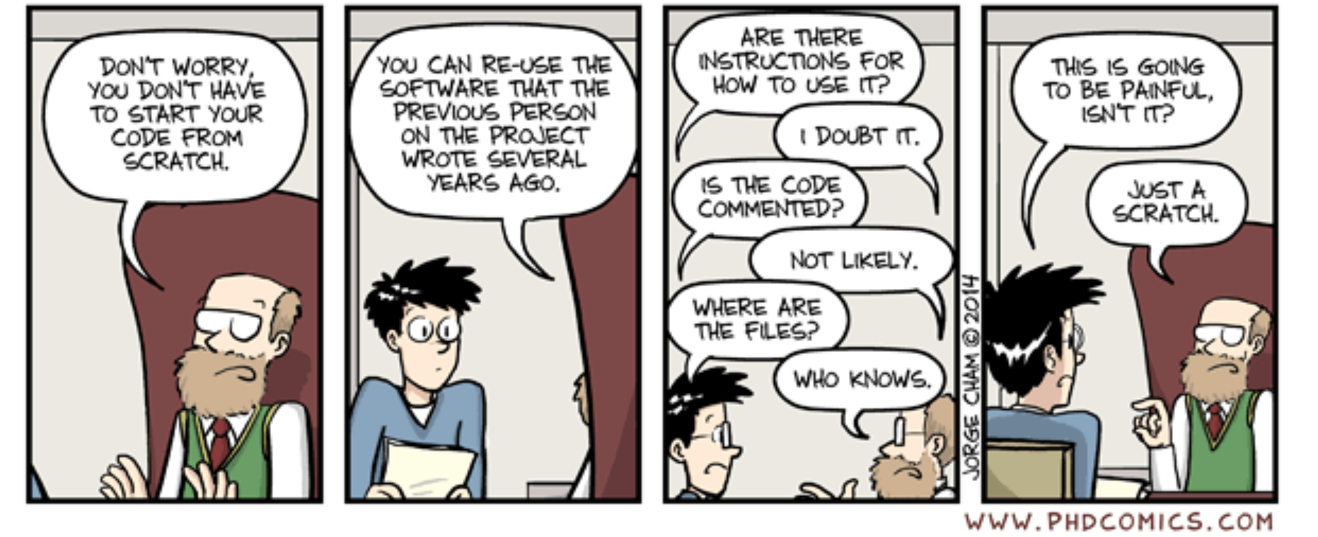
Why reproducible research? Reusability
http://phdcomics.com/coamics/archive.php?comicid=1689

Slide 6
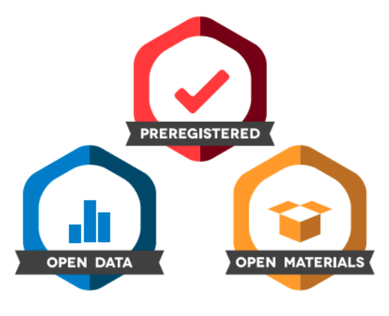
Seriously, why reproducible research?
Why is this important?
Show evidence of the correctness of our results
Enable others to make use of our methods and results
(including future you)
Increasingly encouraged or required by funders and journals
http://ropensci.github.io/reproducibility-guide/sections/introduction/
https://www.stat.berkeley.edu/~stark/Seminars/reproNE16.htm
https://twitter.com/jeltewicherts/status/863329455191851009
https://cos.io/our-services/open-science-badges
Notes:
Roger Peng emphasizes that reproducibility is the one aspect researchers have most control over

Slide 7
“reproducibility”

Slide 8
What does reproducibility mean? Three ideas to distinguish
1. Reproducibility (sometimes called repeatability or even ‘preproducibility’) [6]
Data, and/or statistical methods, code, software environment are available
so data analysis can be repeated and get a similar result [1, 2, 3]
2. Replicability (sometimes called reproducibility)
Another researcher is able to conduct the same experiment and get similar results
3. Correctness
Is your analysis appropriate? Is your hypothesis correct?
→ Reproducible research can still be wrong! [4]
1 - Peng Science 2011, DOI: 10.1126/science.1213847
2 - http://ropensci.github.io/reproducibility-guide/sections/introduction/
3 - https://simplystatistics.org/2014/06/06/the-real-reason-reproducible-research-is-important/, Peng 2014
4 - Reproducible research can still be wrong, Leek, Peng
PNAS 2015, DOI: 10.1073/pnas.1421412111
5- https://www.nature.com/news/muddled-meanings-hamper-efforts-to-fix-reproducibility-crisis-1.20076#/b1, citing https://www.ascb.org/wp-content/uploads/2015/11/How-can-scientist-enhance-rigor.pdf citing Schmidt, Stefan. (2009). Shall We Really Do It Again? The Powerful Concept of Replication Is Neglected in the Social Sciences. Review of General Psychology. 13. 90-100. 10.1037/a0015108.
6 – Barba 2018 https://arxiv.org/pdf/1802.03311.pdf
Notes:
Roger Peng emphasizes that reproducibility is the one aspect researchers have most control over
Data sharing restrictions: https://simplystatistics.org/2018/05/15/rethinking-academic-data-sharing/
The importance of professional working relationships: https://simplystatistics.org/2018/04/23/what-can-we-learn-from-data-analysis-failures/
Also looked at: https://www.slideshare.net/CTobinMagle/reproducible-research-74939654

Slide 9
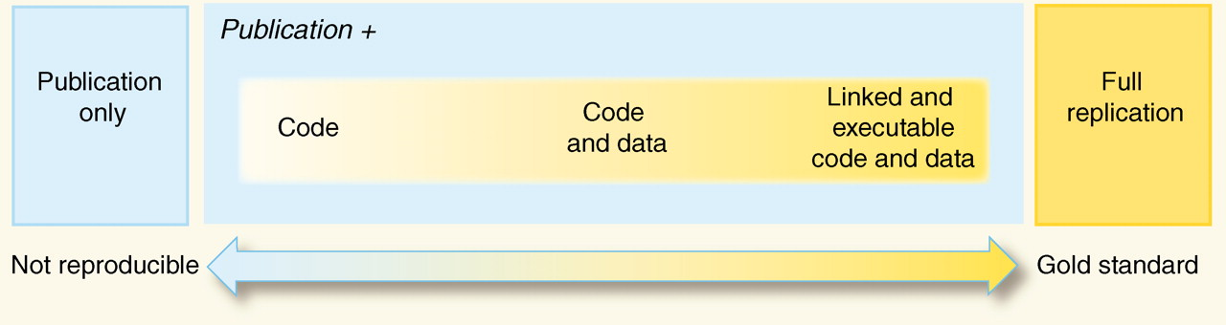
A spectrum of practice (depends on project)
or data
Adopted from:
Reproducible Research in Computational Science
By Roger D. Peng
Science 02 Dec 2011 : 1226-1227
http://science.sciencemag.org/content/334/6060/1226.full
Notes:
Make building sci version

Slide 10
What are some examples of good practices we can start using now?

Slide 11
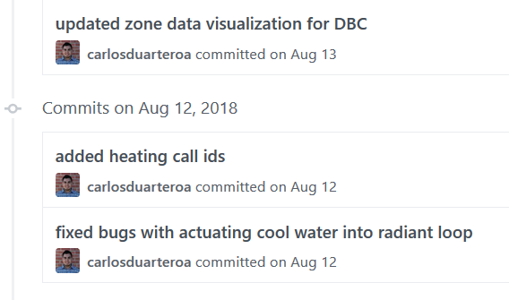
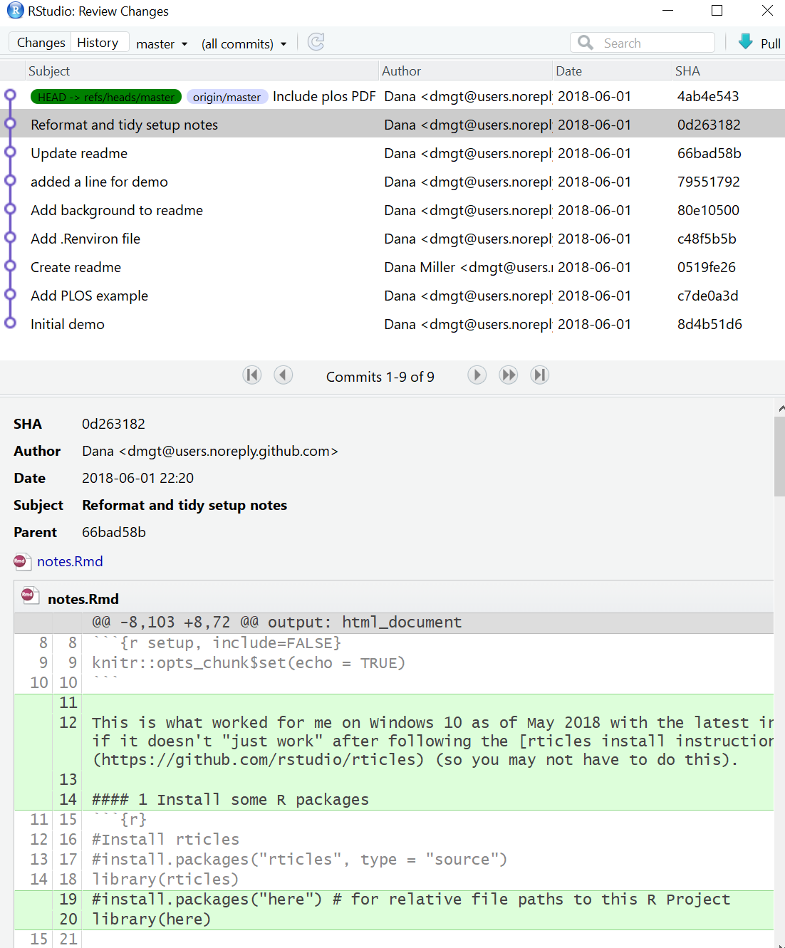
Data analysis
1. File organization
Suggest one folder per project, eg:
2. Version control (for code)
Like MS Word’s Previous Versions → Restore,
or unlimited undo for your R scripts
My_project
Data
raw_data.csv
Docs
Manuscript.doc
Results
Processed_results.csv
Scripts
clean_data.R
fit_model_and_graph.R
Resources:
A Quick Guide to Organizing Computational Biology Projects
Good enough practices in scientific computing
Resources:
http://happygitwithr.com/
A quick introduction to version control with Git and GitHub
Notes:
TODO add SWC

Slide 12
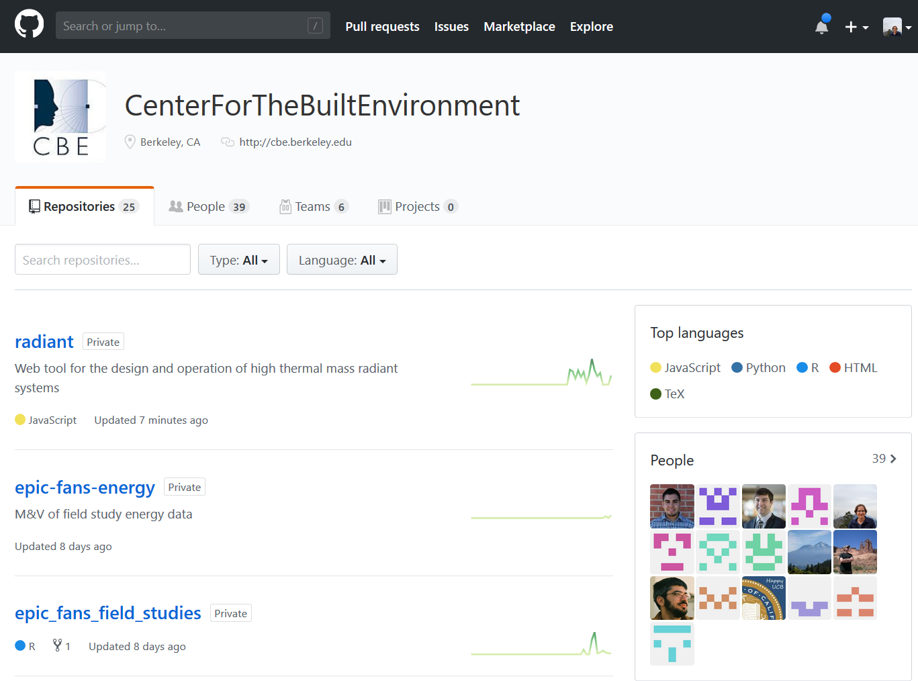
Sharing + publication of results
Data repositories
UC system – dash
Example: ASHRAE Global Thermal Comfort Database II
2. Code repositories
Resources:
Berkeley Research Data Management librarians!
Other repositories include Zenodo, Open Science Framework, DataDryad, Figshare
Resources:
Software Carpentry’s Intro to Version Control for Novices
A quick introduction to version control with Git and GitHub
Notes:
www.rstudio.com/wp-content/uploads/2015/02/data-wrangling-cheatsheet.pdf

Slide 13
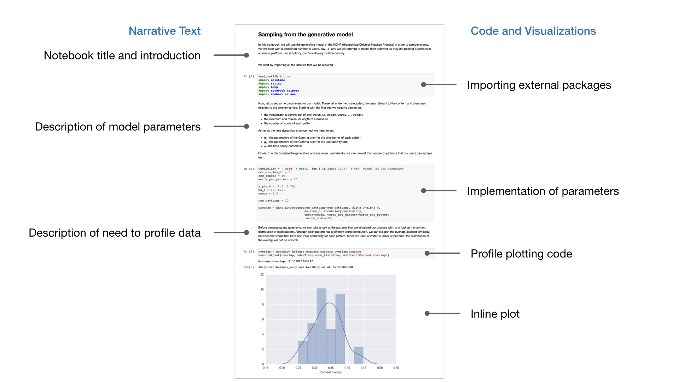
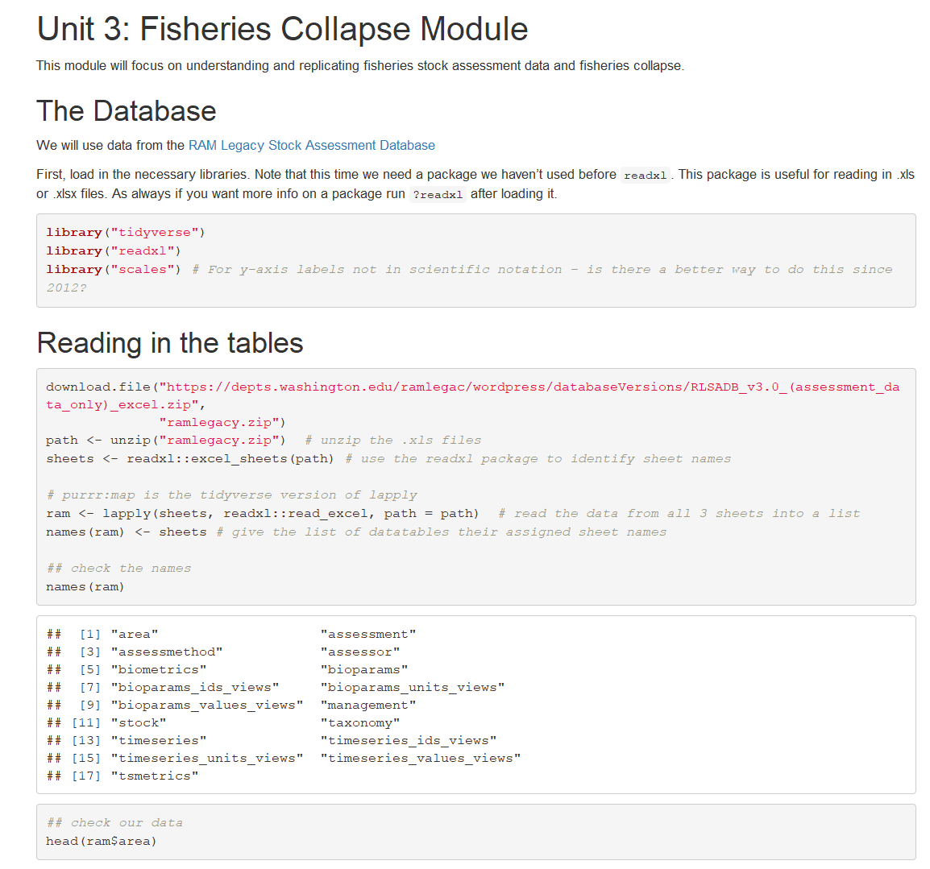
Other interactive notebooks:
Beaker (Two Sigma)
Zeppelin (Apache)
Databricks (Databricks)
Two very common (and free) interactive notebooks:
Jupyter
R Markdown
https://github.com/ds421/fish-template/blob/master/assignment/fish-assignment.Rmd
https://github.com/activityhistory

Slide 14
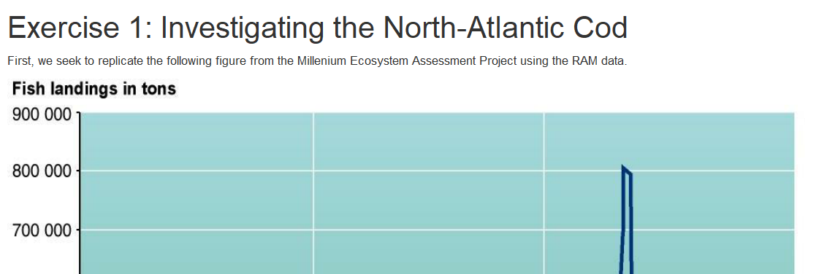
Similarities of Jupyter and R notebooks – compatible with best practices
Embed code in a narrative written for humans to read (‘literate programming’)
Script repetitive tasks so computers, not humans, repeat them
Write code in small steps with immediate feedback
Visualize data frequently
Import mature packages/libraries to build on existing methods
Use version control (good for R, Jupyter is still harder)
Easy to share with other people
All but data visualization based on Wilson G, Aruliah DA, Brown CT, Chue Hong NP, Davis M, Guy RT, et al. (2014) Best Practices for Scientific Computing. PLoS Biol 12(1): e1001745. https://doi.org/10.1371/journal.pbio.1001745
https://www.coursera.org/learn/reproducible-research/lecture/oM6Xq/scripting-your-analysis

Slide 15
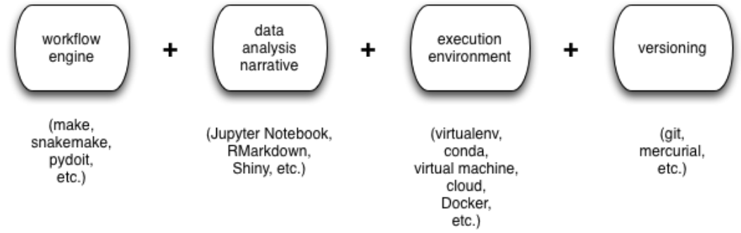
Interactive notebooks are one part of a toolset for reproducibility
(in R: drake
from ROpenSci)
introduced in these slides
mentioned but not primarily introduced in these slides
Adapted from slide by C Titus Brown, UC Davis
https://2016-oslo-repeatability.readthedocs.io/en/latest/overview-and-agenda.html
Notes:
Wider universe of tools, eg:
https://www.vistrails.org/index.php/Main_Page
https://taverna.incubator.apache.org/

Slide 16
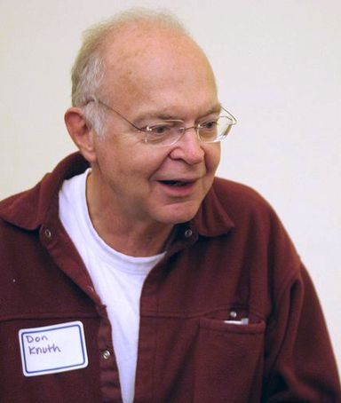
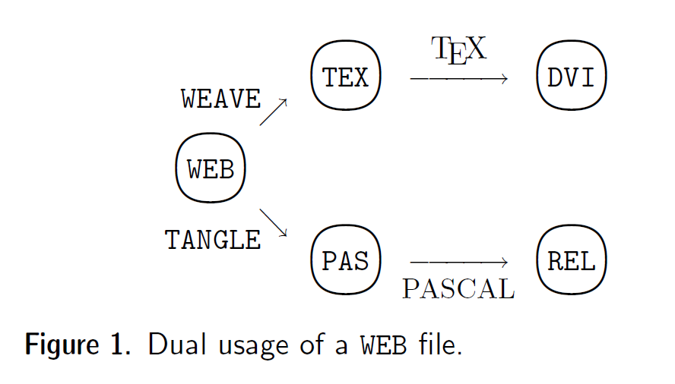
Background– what is literate programming?
What is literate programming?
“Instead of imagining that our main task is to instruct a
computer what to do, let us concentrate rather on explaining to human beings what we want a computer to do.”
- Donald Knuth (1984)
https://en.wikipedia.org/wiki/Donald_Knuth#/media/File:KnuthAtOpenContentAlliance.jpg
D. E. Knuth; Literate Programming, The Computer Journal, Volume 27, Issue 2, 1 January 1984, Pages 97–111, https://doi.org/10.1093/comjnl/27.2.97
https://www.coursera.org/learn/reproducible-research/lecture/oM6Xq/scripting-your-analysis

Slide 17
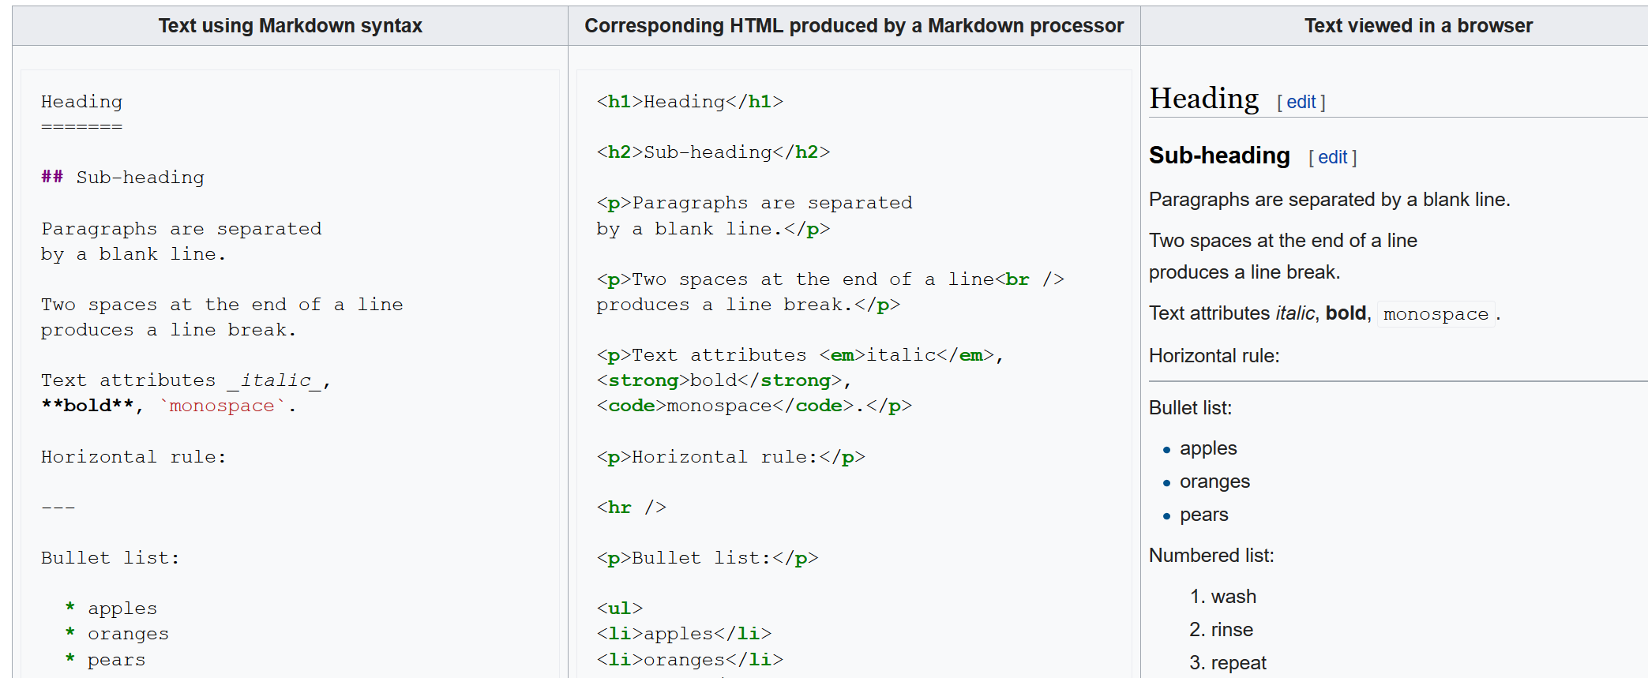
What is markdown?
https://en.wikipedia.org/wiki/Markdown

Slide 18
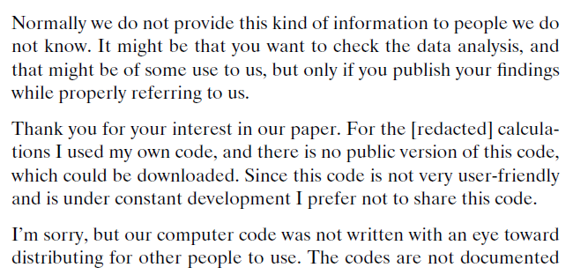
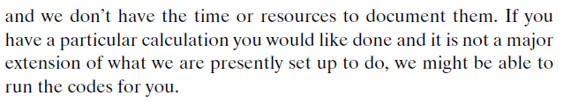
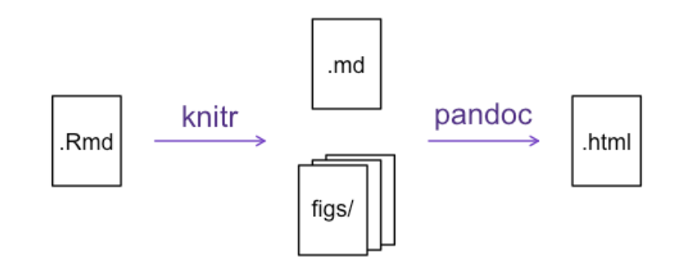
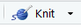

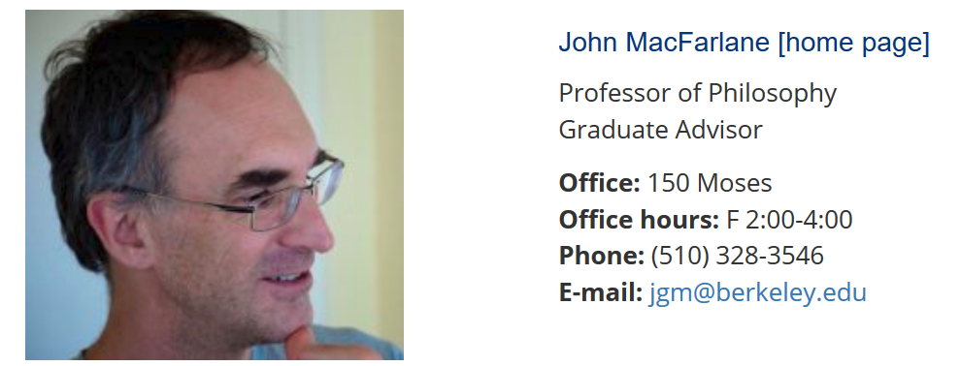
.Rmd files combine code and text and convert to many formats
.doc
Mention pandoc
.tex
.pdf
https://usesthis.com/interviews/yihui.xie/
https://philosophy.berkeley.edu/people/detail/1
Yihui Xie
RStudio
(Iowa State Statistics PhD)
John Macfarlane
Philosophy, UC Berkeley
https://swcarpentry.github.io/r-novice-gapminder/15-knitr-markdown/
Try pandoc
Notes:
* Latex goes back to the 80's, a way, in principle, or separating the authoring of content from how it's presented
* Pandoc created by John MacFarlane at Berkeley (Professor of Logic)
* Jupyter notebooks can also be rendered to markdown and converted to other formats with pandoc
* Can install 'article' package to import templates for different article formats (requires LaTeX, look at tinyTEX)
* .tex → pdf uses pdf atex

Slide 19

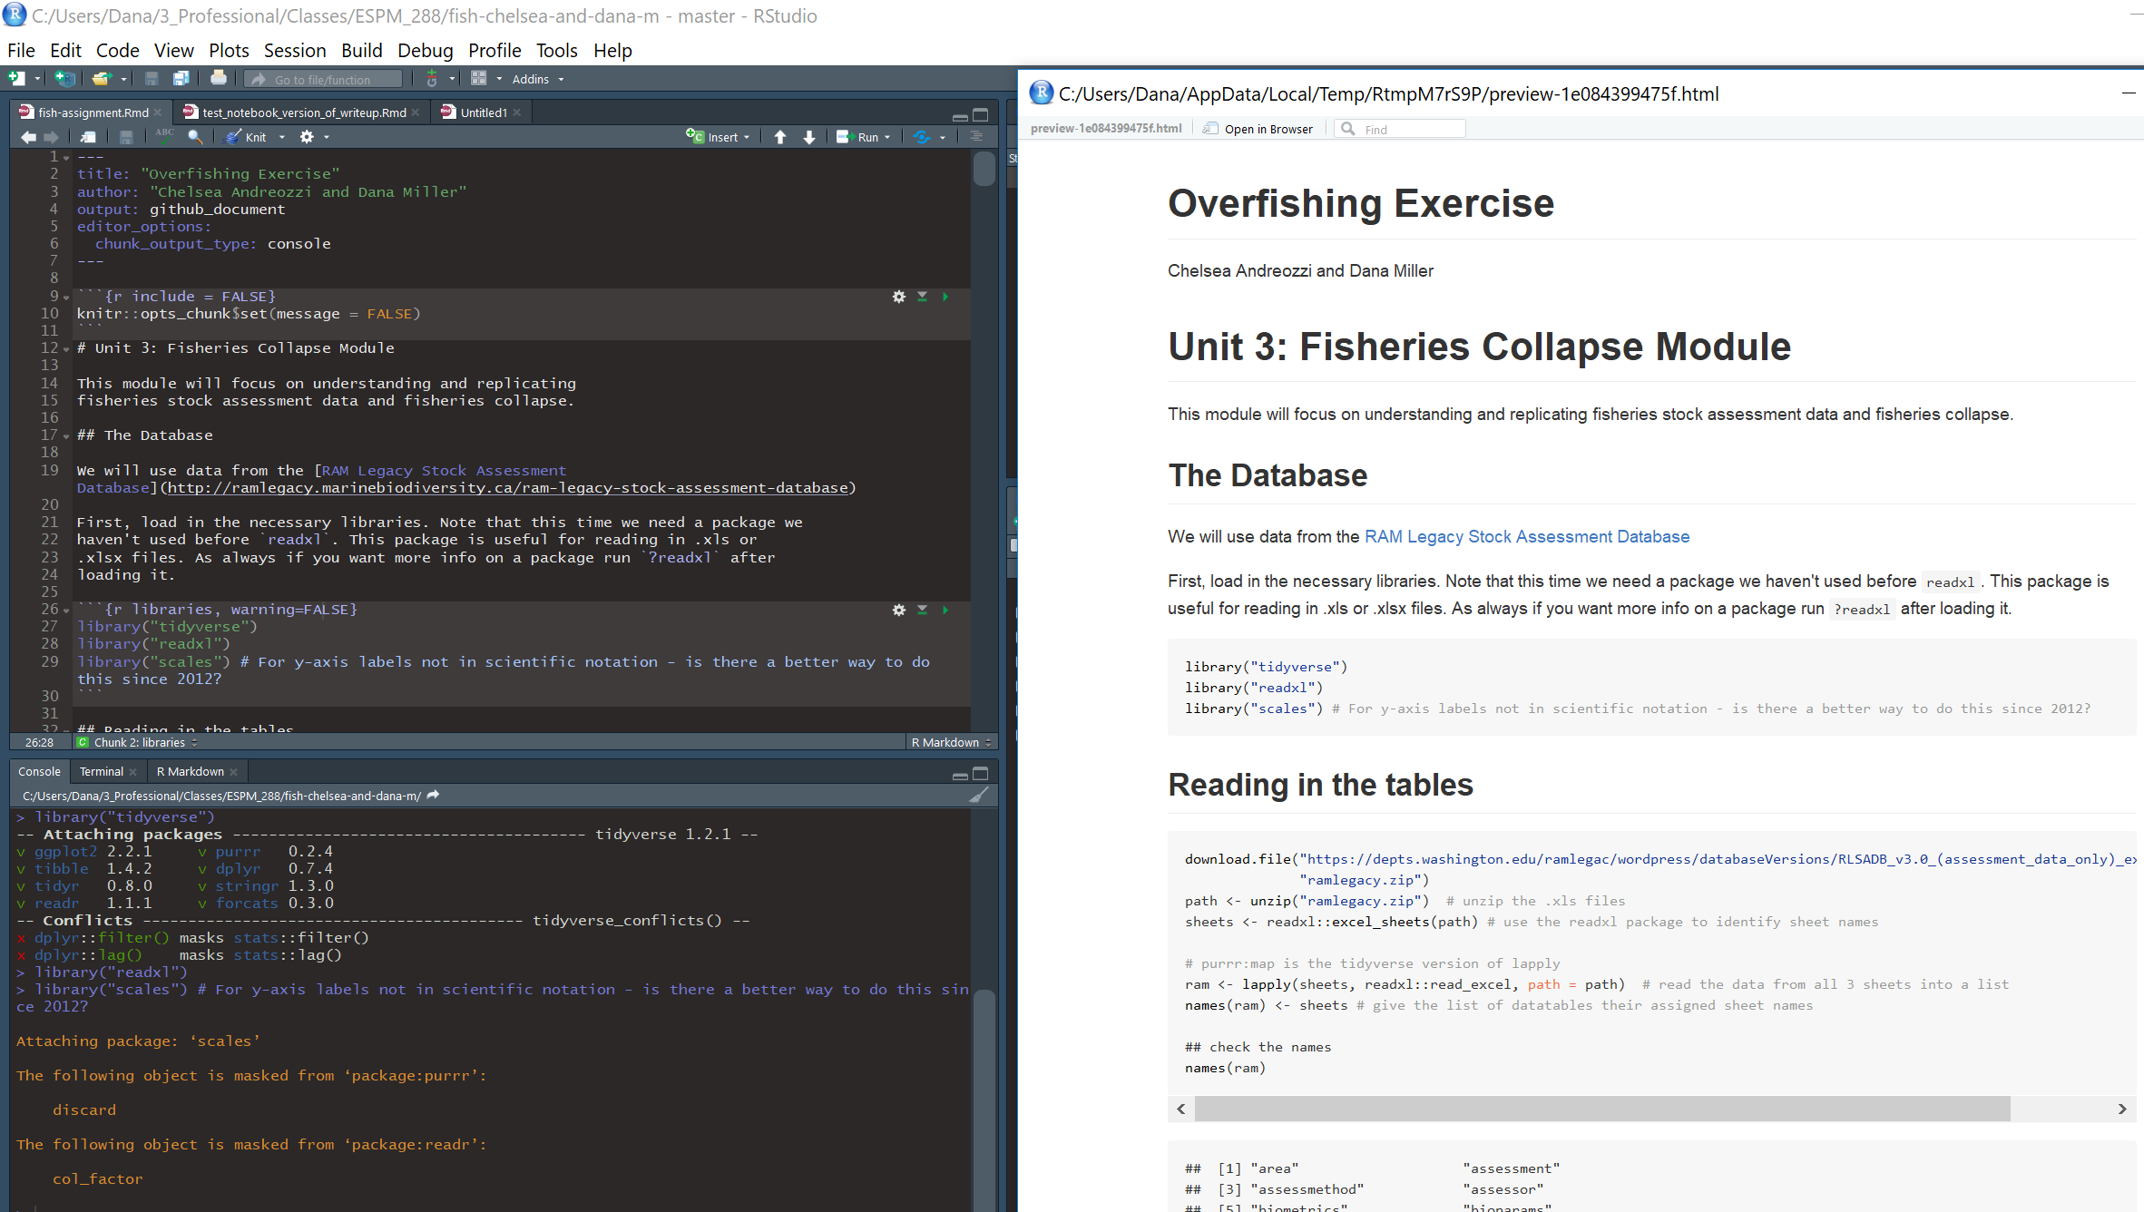
Literate programming example with R Markdown
This button or command:
renders formatted document
with executed code and text
(.md, .pdf, .doc etc)
Starting with one
.Rmd file with both R code and text
This button or command:
executes all R code
(output shown in console)

Slide 20
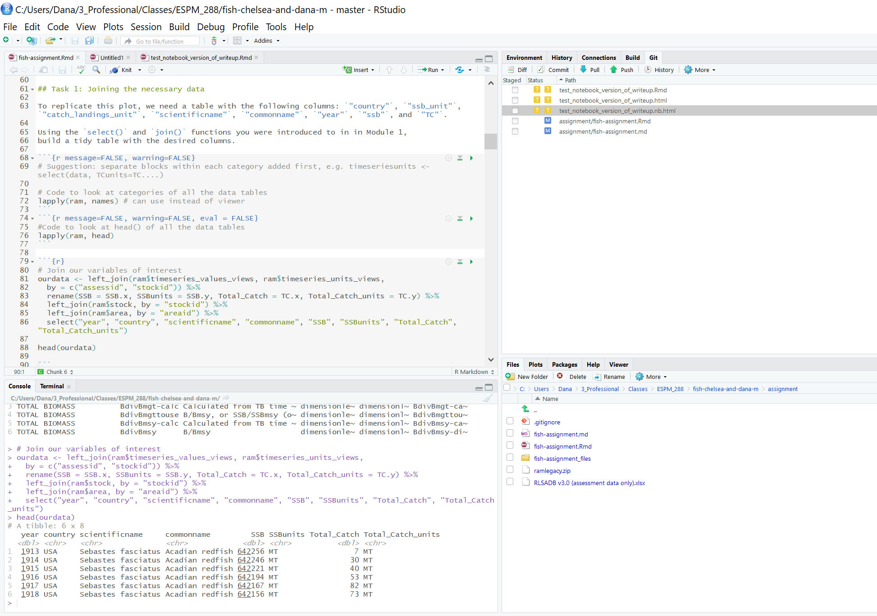
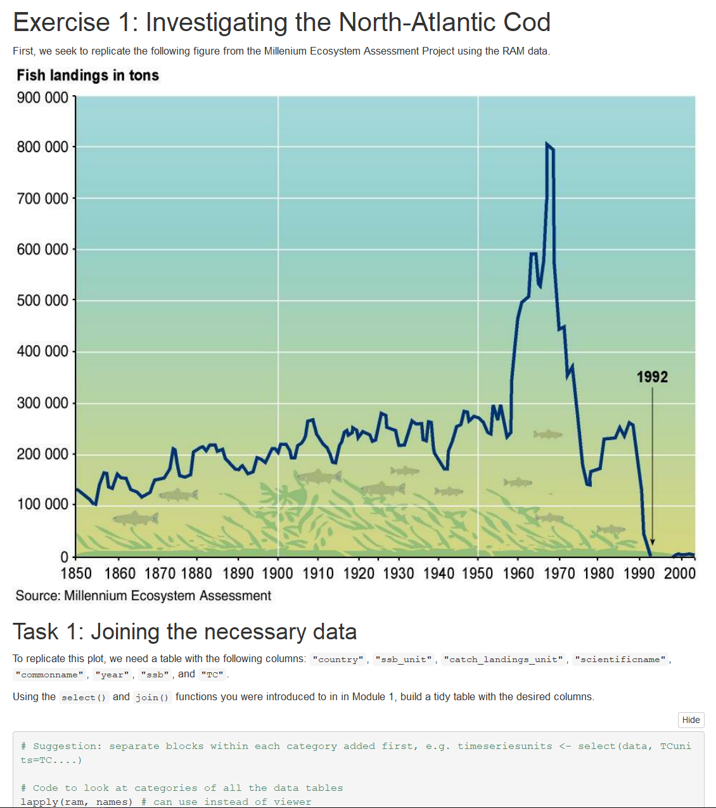
R Markdown documents – key features
Version control
tracker
See happygitwithr
History
Rstudio ~ 2011
knitr ~ 2012
Markdown rendering ~ 2013
R Notebook ~ 2016
R Markdown (.Rmd) document mixing code and text
Code can be executed in-line (above) or in console (below)
See file explorer, help documentation, plots, packages
Convert file to .md, .doc, .pdf, html, html notebook, slides,
book, blog, dashboards, Shiny app, etc
See R Markdown output formats
Notes:
More features:
Can run python or SQL
Easy to share online (Rpubs, GitHub)
http://minimaxir.com/2017/06/r-notebooks/
https://towardsdatascience.com/5-reasons-why-jupyter-notebooks-suck-4dc201e27086
Output formats as of May 2018:
Documents
html_notebook - Interactive R Notebooks
html_document - HTML document w/ Bootstrap CSS
pdf_document - PDF document (via LaTeX template)
word_document - Microsoft Word document (docx)
odt_document - OpenDocument Text document
rtf_document - Rich Text Format document
md_document - Markdown document (various flavors)
Presentations (slides)
ioslides_presentation - HTML presentation with ioslides
revealjs::revealjs_presentation - HTML presentation with reveal.js
slidy_presentation - HTML presentation with W3C Slidy
beamer_presentation - PDF presentation with LaTeX Beamer
More
flexdashboard::flex_dashboard - Interactive dashboards
tufte::tufte_handout - PDF handouts in the style of Edward Tufte
tufte::tufte_html - HTML handouts in the style of Edward Tufte
tufte::tufte_book - PDF books in the style of Edward Tufte
html_vignette - R package vignette (HTML)
github_document - GitHub Flavored Markdown document
You can also build books, websites, and interactive documents with R Markdown.

Slide 21
Demo: R Markdown
R demos!
Learning objectives:
1.
How to create a new R Markdown document in Rstudio
Make edits
Knit it
Share it somewhere
Have someone else download and run it
2.
Example of paper written in R Markdown
Limitations of R + RMarkdown
Not a “general purpose programming language”
By default, loads entire data into memory
Less widely used in industry than python
Possible to run chunks out of order (but can “run all”)
Reference to set up git w/ R: http://happygitwithr.com
https://www.coursera.org/learn/reproducible-research/lecture/oM6Xq/scripting-your-analysis
Notes:
- Class assignments using R could be written up + submitted in R Markdown
- Rmd is a good format for adding comments + images etc to any code shared online
Also a potential format for making R code from research available with minimal conversion – share Rproject with some data, code, and comments in R Markdown
For individual researchers, a way to integrate ongoing analysis notes with code

Slide 22
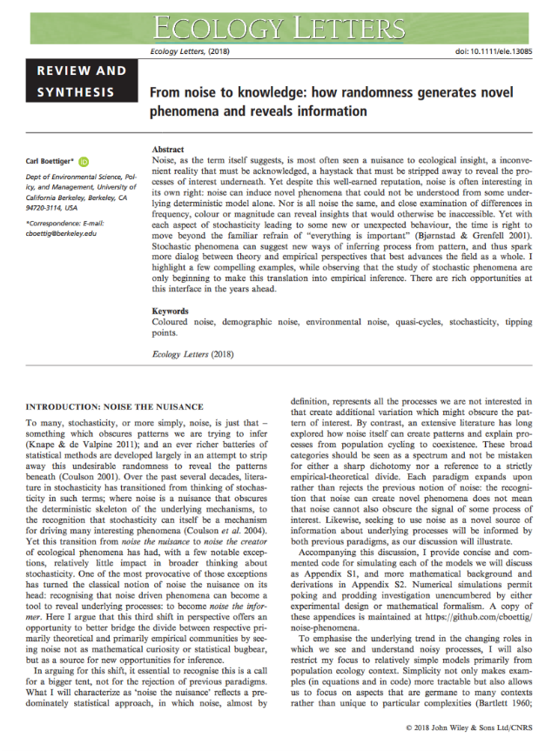
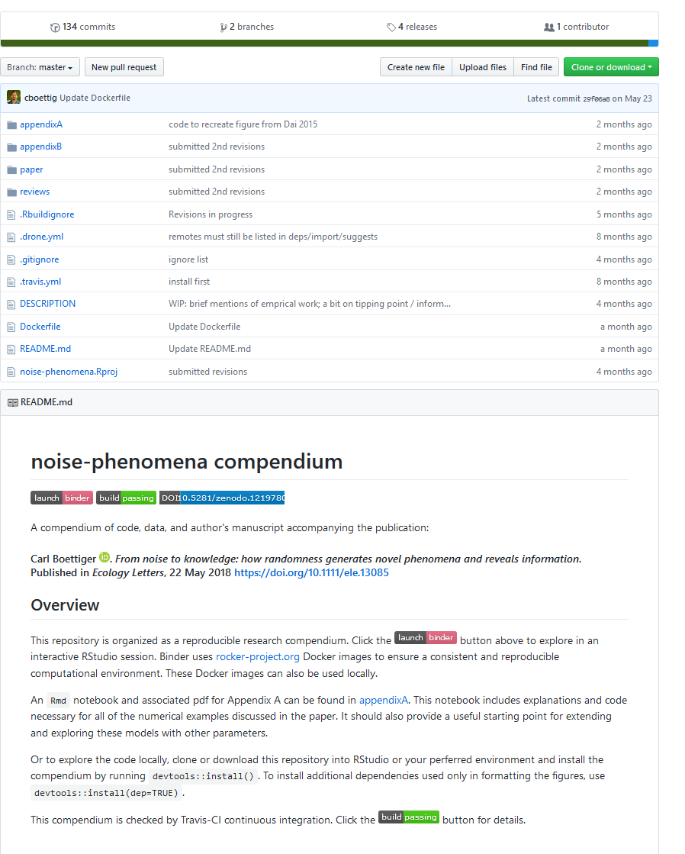
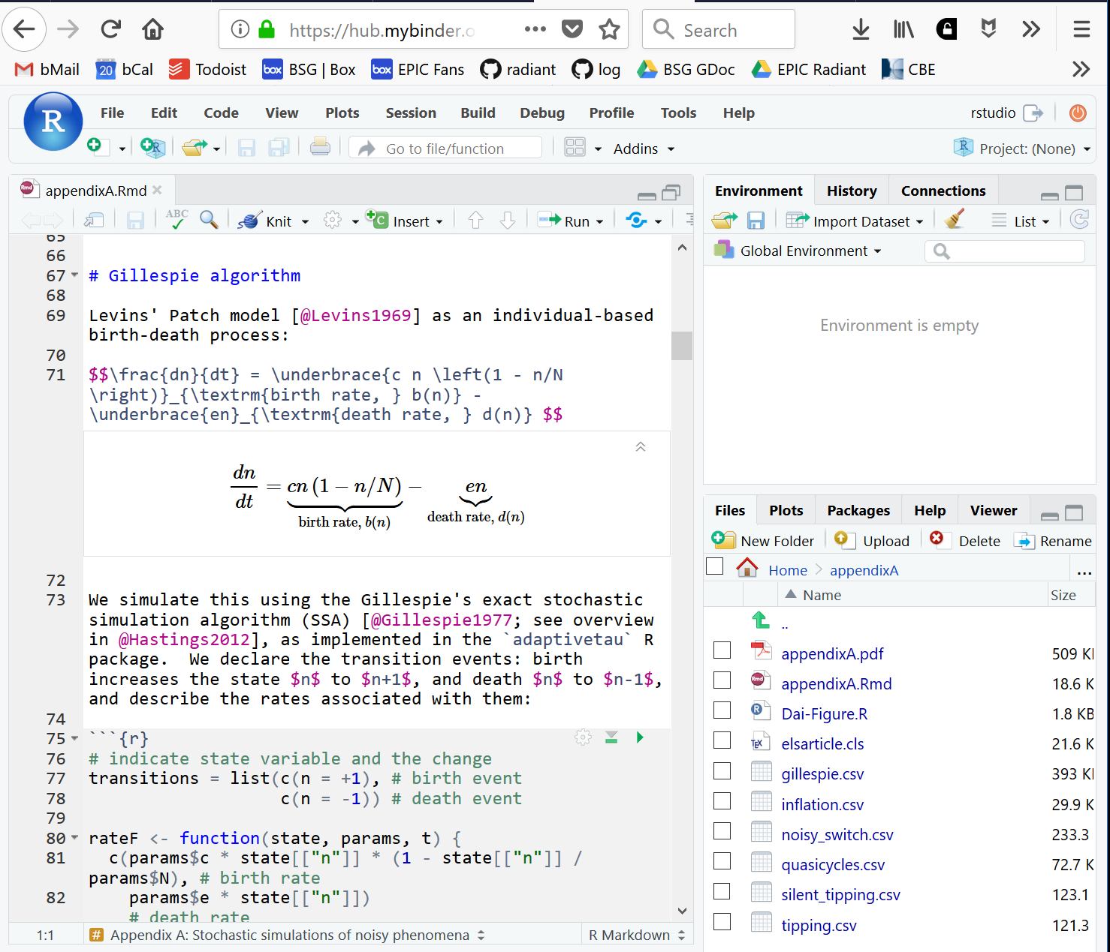
Interactive publications
New paper
(open access)
Corresponding “compendium” (with text, code, data)
Interactive R Markdown notebook to explore code
(with all required files and software ready to run in Rstudio in your browser with no installation required, thanks to Binder)
https://onlinelibrary.wiley.com/doi/epdf/10.1111/ele.13085
https://github.com/cboettig/noise-phenomena

Slide 23

Demo – reproduce a figure from paper on the previous slide
Even more vocabulary for reproducibility
See the paper: https://onlinelibrary.wiley.com/doi/epdf/10.1111/ele.13085
- Note the PDF includes a link to a GitHub repo
2. Inspect the code
Open the associated GitHub repository containing the code and data used to produce the figures for the paper
Repo: https://github.com/cboettig/noise-phenomena
Code for the paper: https://github.com/cboettig/noise-phenomena/blob/master/paper/paper.Rmd
3. Reproduce a figure without installing anything on your local computer!
Click the button on the main page of the repo

Slide 24
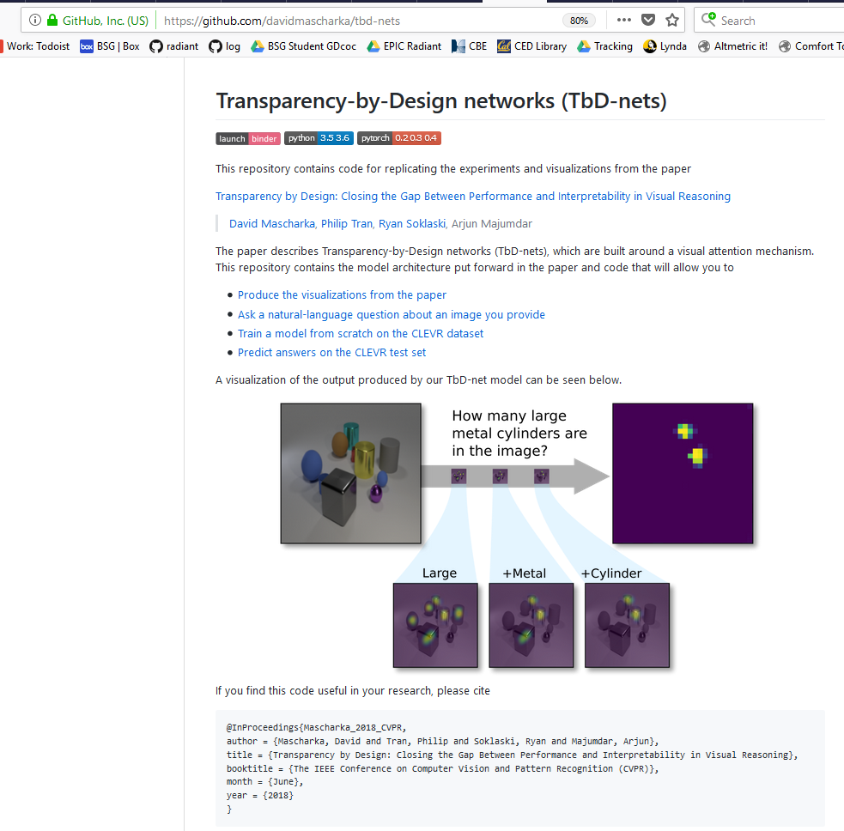
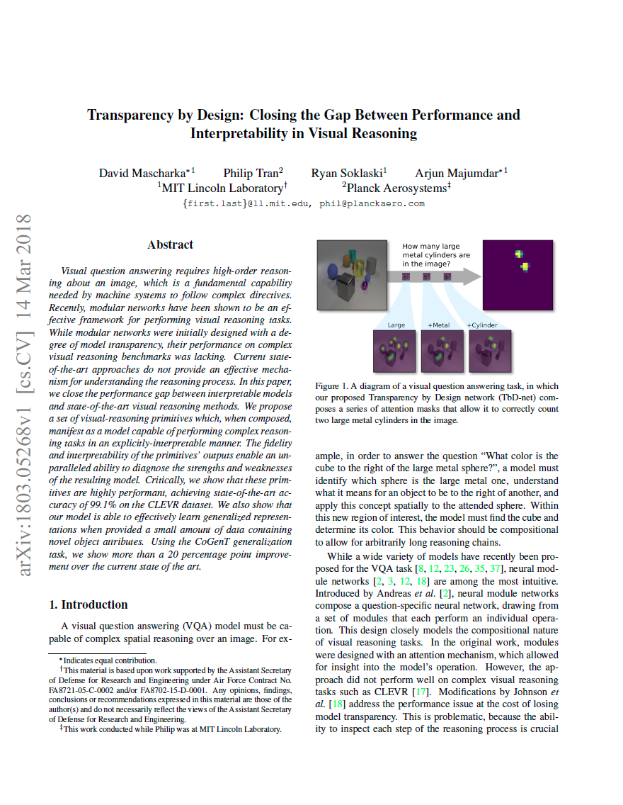
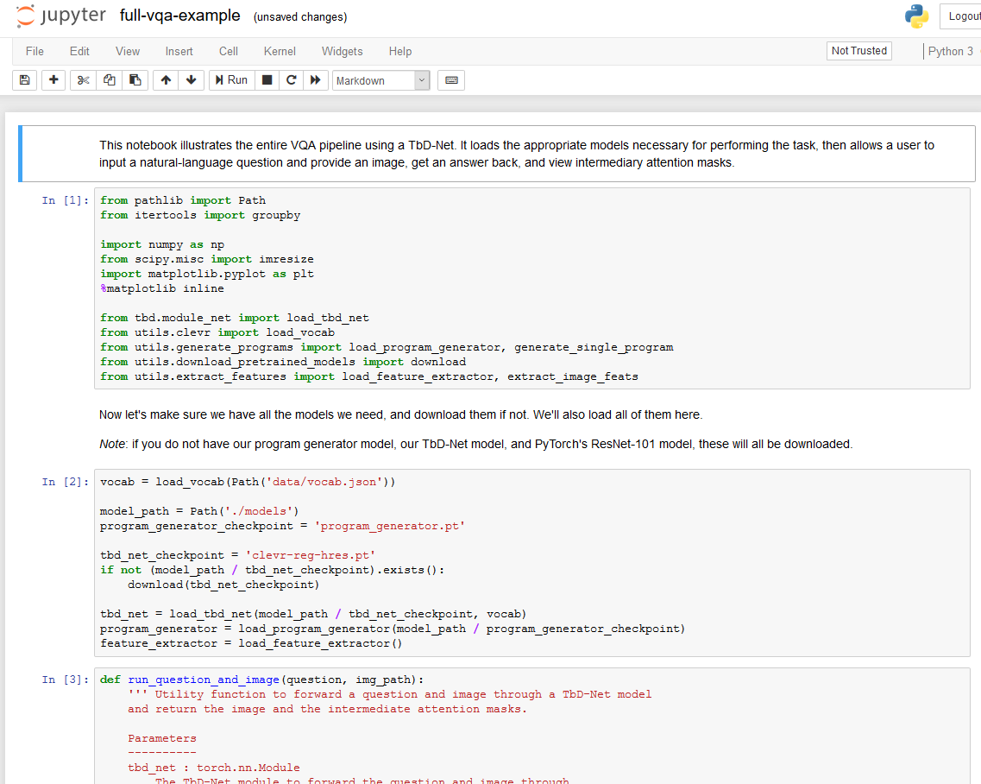
Interactive publications – in python too!
New paper
(in this case, a preprint)
+
Website explaining paper
(has code to replicate experiments + plots and explicit software versions)
+
Interactive Jupyter notebook with code to apply their method to your own images
(with all required files and software ready to run in your browser with no installation required, thanks to Binder)
https://arxiv.org/abs/1803.05268
https://github.com/davidmascharka/tbd-nets
https://mybinder.org/v2/gh/davidmascharka/tbd-nets/binder?filepath=full-vqa-example.ipynb
Additional reference: Link to tweet by first author publicizing this work

Slide 25
What next?
UCB Prof Phillip Stark on reproducibility:
“Science is show me, not trust me”
“Perfection is impossible but improvement is easy”
There are many communities who can help!
And we can learn a lot from each other ☺
Software Carpentry, R for Data Analysis (R4DS), RBloggers, PyData (also has R videos), RLadies, #rstats…
https://www.stat.berkeley.edu/~stark/Seminars/reproNE16.htm

Slide 26
Some more R resources
R for Data Science:
https://r4ds.had.co.nz
Free resources aimed at beginners: 1. introduction to programming in R
2. Reproducible scientific analysis using RStudio and R
Useful but not fully free:
Datacamp - Each of these video tutorial series + hands on exercises is free to start and then unfortunately requires a paid subscription to continue. If you are in a class with more than 10 students, the instructor can sign up and then all the students can get access for the whole semester for free
Introduction to the RStudio IDE
Introduction to the tidyverse: https://www.datacamp.com/courses/introduction-to-the-tidyverse
Generating reports with R markdown: https://www.datacamp.com/courses/reporting-with-r-markdown
From Excel to R: http://rpubs.com/acolumbus/how-to-use-r-with-excel (includes list of common Excel functions in R)
https://rosannavanhespenresearch.wordpress.com/2016/02/03/writing-your-thesis-with-r-markdown-1-getting-started/
Markdown guide:
https://bookdown.org/yihui/rmarkdown/
Notes:
For additional reference if needed:
3. For more reference on statistics in R, Stefano recommends pgs 1-23 of the book attached (Simple R)
4. For setting up or troubleshooting problems if you use R with git for version control: http://happygitwithr.com/
For help, the RBloggers blog aggregator has many helpful tutorials, and try looking on StackOverflow (though information can be outdated), R Studio cheatsheet for reference
Resources that are useful but are not fully free:
Datacamp - Each of these video tutorial series + hands on exercises is free to start and then unfortunately requires a paid subscription to continue. If you are in a class with more than 10 students, the instructor can sign up and then all the students can get access for the whole semester for free (this is what my class this semester did, and Stefano did this for his class last year). Otherwise a subscription is $29/month. Datacamp is *not* blocked in China, so you can ask your faculty to sign your classes up in future semesters.
Introduction to the RStudio IDE
Introduction to the tidyverse: https://www.datacamp.com/courses/introduction-to-the-tidyverse
Generating reports with R markdown: https://www.datacamp.com/courses/reporting-with-r-markdown

Slide 27
Bonus slides! (for reference)

Slide 28
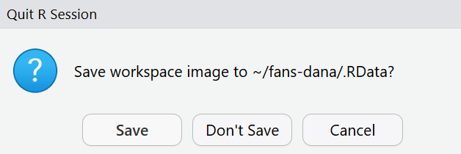
Three R tips you can start using today:
here::here (use with RProject)
Freedom from hardcoded file paths!
library(here)
db <- read_csv(here(“subfolder_name", “file_name.csv”))
read_csv
tidyverse version of read.csv
won’t coerce strings to factors, outputs a dataframe (tibble)
“Save workspace image?”
Don’t save!
https://www.coursera.org/learn/reproducible-research/lecture/oM6Xq/scripting-your-analysis

Slide 29
Where do we go from here?
ROpenSci’s perspective:
Train students by putting homework, assignments & dissertations on the reproducible research spectrum
Publish examples of reproducible research in our field
Request code & data when reviewing
Submit to & review for journals that support reproducible research
Critically review & audit data management plans in grant proposals
Consider reproducibility wherever possible in hiring, promotion & reference letters.
http://ropensci.github.io/reproducibility-guide/sections/introduction/ - Leveque et al

Slide 30
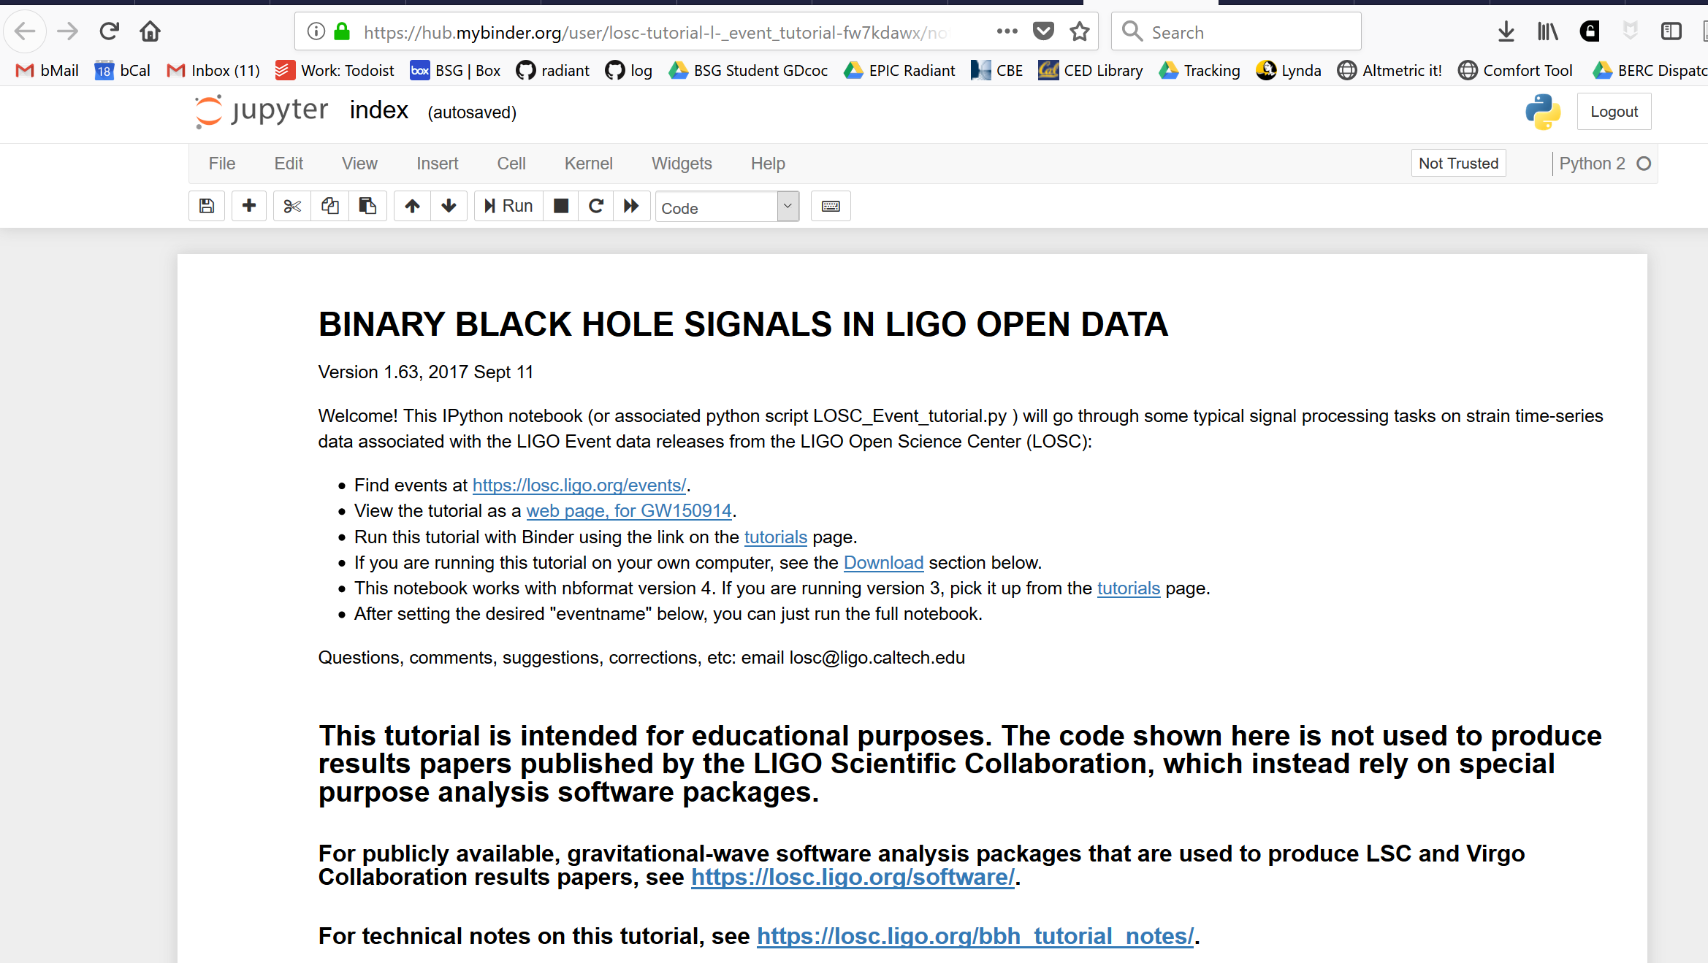
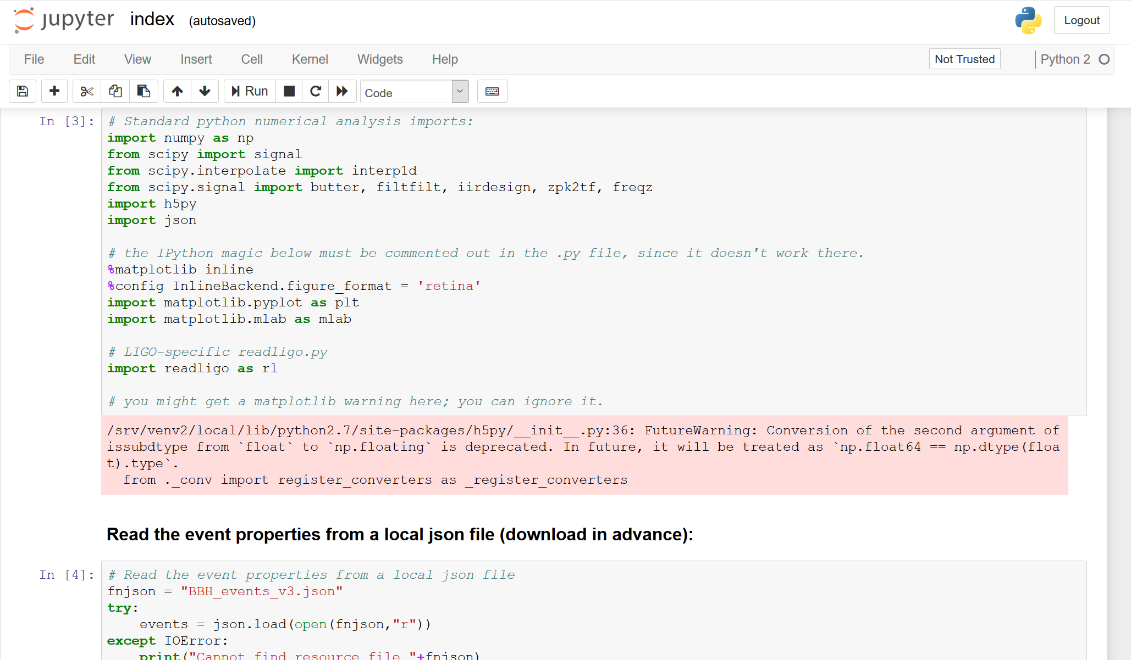
How does Binder work?
“Binder allows you to create custom computing environments that can be shared and used by many remote users”
https://mybinder.readthedocs.io/en/latest/
Visible in your browser,
but running on a remote machine
Your browser
Specified version
of Python
(or other kernels eg R)
You see the code in the .ipynb file

Slide 31
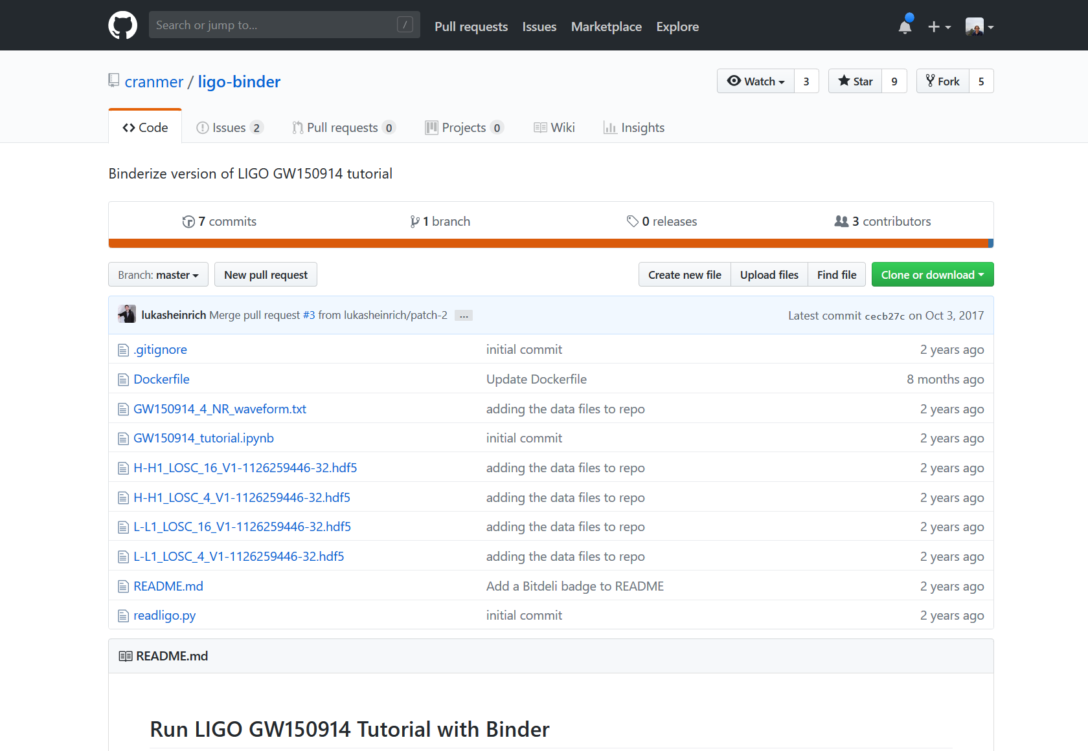
How does Binder work?
Code for notebook and list of dependencies and files available on GitHub (right now Binder only works with public repositories)
+
Your browser
Notes:
This is my current understanding
https://jupyterhub.readthedocs.io/en/stable/
https://binderhub.readthedocs.io/en/latest/overview.html

Slide 32


How does Binder work?
builds Docker image based on repo and generates URL for public access
Docker image
+
Code and dependencies in repo
+
required
software + packages
Your browser
included
data
Notes:
This is my current understanding
https://jupyterhub.readthedocs.io/en/stable/
https://binderhub.readthedocs.io/en/latest/overview.html

Slide 33


Cloud hosting + management
+
How does Binder work?
Docker image
+
JupyterHub
+
Code and dependencies in repo
+
required
software + packages
Your browser
Kubernetes
included
data
Generated binders are hosted by a hub that deploys, scales, and manages compute resources
using Kubernetes
(can run on any cloud platform provider)
More details: BinderHub
Notes:
This is my current understanding
https://jupyterhub.readthedocs.io/en/stable/
https://binderhub.readthedocs.io/en/latest/overview.html

